Slide 1

TEDx IITGandhinagar Orientation
TEDxIITGANDHINAGAR
Here is where your presentation begins
08/2023
TEDxIITGANDHINAGAR

Slide 2
TEDxIITGANDHINAGAR
TEDxIITGANDHINAGAR
ABOUT TED
National Motorcycle Day on encourages motorcyclists around the country to join the campaign to spread good in their communities. Even modest gestures, such as buying a stranger a cup of coffee or engaging in a neighborhood clean-up, can help spread the National Motorcycle Day spirit
02/1984

Slide 3
TEDxIITGANDHINAGAR
TEDxIITGANDHINAGAR
ABOUT TEDx
National Motorcycle Day on encourages motorcyclists around the country to join the campaign to spread good in their communities. Even modest gestures, such as buying a stranger a cup of coffee or engaging in a neighborhood clean-up, can help spread the National Motorcycle Day spirit
02/2023

Slide 4
WHY JOIN TEDxIITGandhinagar ?
TEDxIITGANDHINAGAR
PRESTIGIOUS EVENTS
CURRICULUM VITAE
INTERACTIONS WITH SPEAKERS
Mercury is the closest planet to the Sun
Venus is the second planet from the Sun
Despite being red, Mars is actually a cold place
CONNECTIONS
LINKEDIN
OTHER TEDx
Jupiter is the biggest planet of them all
Saturn is composed of hydrogen and helium
Neptune is the farthest planet from the Sun
TEDxIITGANDHINAGAR

Slide 5

TEDxIITGANDHINAGAR
“He wanted to be spiderman when he was a child, cause at that time he was the only superhero who wore his underwear inside”
02/2014
—HARUN ROBERT
TEDxIITGANDHINAGAR

Slide 6
“He wanted to be spiderman when he was a child, cause at that time he was the only superhero who wore his underwear inside”
TEDxIITGANDHINAGAR
08/2024
—HARUN ROBERT
TEDxIITGANDHINAGAR

Slide 7
“He wanted to be spiderman when he was a child, cause at that time he was the only superhero who wore his underwear inside”
TEDxIITGANDHINAGAR
08/2024
—HARUN ROBERT
TEDxIITGANDHINAGAR

Slide 8
TEDxIITGANDHINAGAR
TEDx HIGHLIGHTS
TEDxIITGANDHINAGAR
02/2023

Slide 9
TEDx
TEDxIITGANDHINAGAR
EVENTS
TEAM
05/2023
TEDxIITGANDHINAGAR

Slide 10
TEDxIITGANDHINAGAR
Scan this
QR code
TEDxIITGANDHINAGAR

Slide 11
TEDxIITGANDHINAGAR
visit this website link
visit this website link
TEDxIITGANDHINAGAR

Slide 12
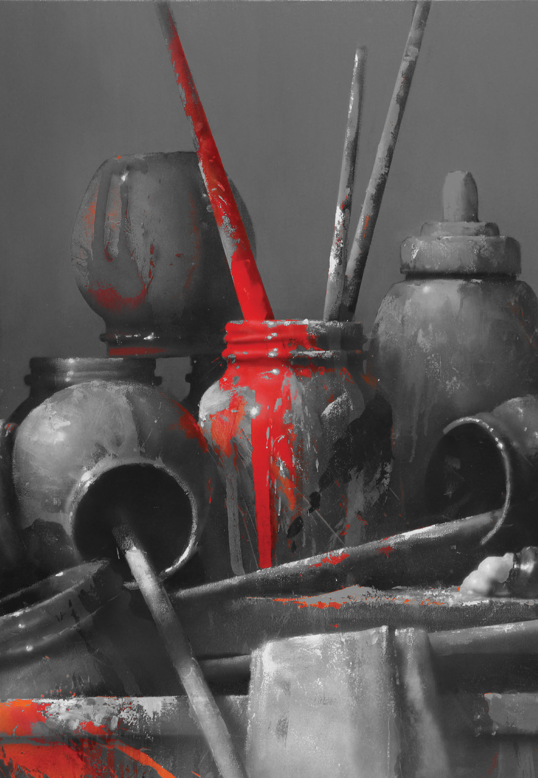
TEDx
TEDxIITGANDHINAGAR
DESIGN
TEAM
05/2023
TEDxIITGANDHINAGAR

Slide 13




TEDxIITGANDHINAGAR
DESIGN SOFTWARES
PHOTOSHOP
ILLUSTRATOR
A raster graphics editor
A graphic design tool
PREMIERE PRO
CANVA
A video editing software
An online graphic design tool
TEDxIITGANDHINAGAR

Slide 14
TEDxIITGANDHINAGAR
TEDxIITGANDHINAGAR MERCH
TEDxIITGANDHINAGAR

Slide 15
TEDx
TEDxIITGANDHINAGAR
MARKETING
TEAM
05/2023
TEDxIITGANDHINAGAR

Slide 16
TEDxIITGANDHINAGAR
600 registrations in
10 min !
TEDxIITGANDHINAGAR
02/2023

Slide 17
TEDx
TEDxIITGANDHINAGAR
SPONSORSHIP
TEAM
05/2023
TEDxIITGANDHINAGAR

Slide 18
TEDx
TEDxIITGANDHINAGAR
TECHNICAL
TEAM
05/2023
TEDxIITGANDHINAGAR

Slide 19


TEDxIITGANDHINAGAR
WEB DEVELOPEMENT
HTML
CSS
Standard markup language for Web pages
Language used to style HTML documents
JAVASCRIPT
REACT
Object-orientated programming language
A javascript library for building user interfaces
TEDxIITGANDHINAGAR

Slide 20
TEDxIITGANDHINAGAR
Would you prefer to design the topic of the show rather than the rundown of event?
Yes
Are you the “brain” of your team?
Yes
No
Do you consider yourself creative?
Is adventurous a good word to describe you?
No
Yes
Do you like to be well-organized?
No
Do you like handling money?
TEDxIITGANDHINAGAR

Slide 21
TEDxIITGANDHINAGAR
DESIGN
Would you prefer to design the topic of the show rather than the rundown of event?
Yes
No
EVENTS TEAM
MARKETING
Is adventurous a good word to describe you?
Yes
No
HUMAN RESOURCE
No
Do you like handling money?
Yes
FINANCE
TEDxIITGANDHINAGAR

Slide 22
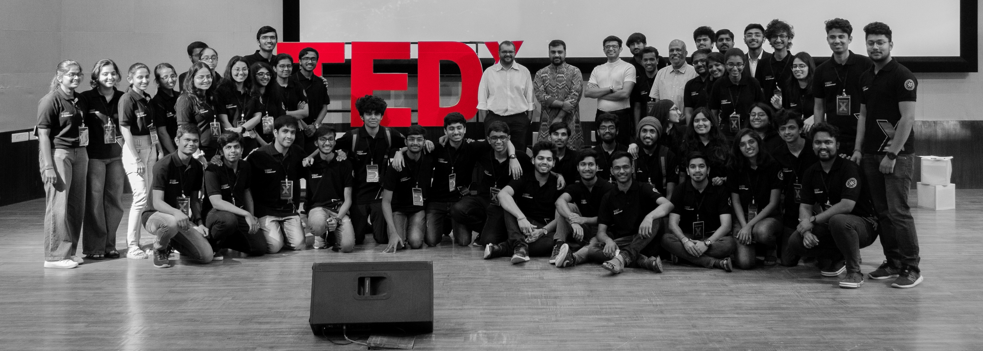
TEDxIITGANDHINAGAR
PREVIOUS TEDx TEAM
12/2022
TEDxIITGANDHINAGAR

Slide 23
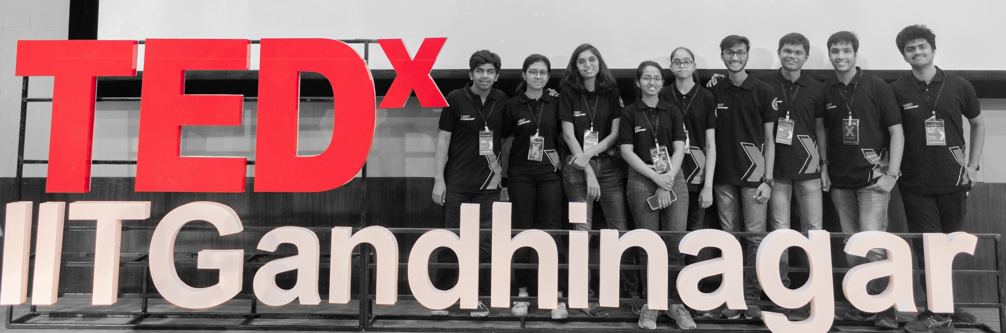
TEDxIITGANDHINAGAR
JUNIOR TEDx TEAM
TEDxIITGANDHINAGAR
12/2022

Slide 24
TEDxIITGANDHINAGAR
OUR TEAM
TEDxIITGANDHINAGAR

Slide 25
THANKS!
Do you have any questions?
TEDxIITGANDHINAGAR
08/2023
TEDxIITGANDHINAGAR

